Slide 1

Microsoft Azure Workshop Serverless computing and microservice architectures with Azure Service Fabric Masterclass
David Gristwood
David.Gristwood@microsoft.com
@ScroffTheBad

Slide 2


Agenda 11th April 2017
10:00 Welcome and overview | David Gristwood
10:30 Azure Functions | Martin Beeby
11:30 Coffee
12:00 Enabling DevOps practices with Containers, Docker, Linux, Windows etc | Marcus Robinson
12:50 Partnering with Microsoft | Mitch Taylor
1pm Lunch
2pm Service Fabric Masterclass plus Project Orleans | Joni Collinge & David Gristwood
(End 4:30 or so)
#msdevuk #azure
VIPazure@microsoft.com
https://github.com/dxuk/
AzureWorkshops

Slide 3
What’s next….
Themed Azure workshops
Open Source and Digital Transformation on Azure – 16th May
DevOps with Visual Studio – May 17th
Azure “best practices” workshops
How to Deploy, Manage, Support and Operate Azure Based Services – May 23rd
Management, Control and Sizing Workshop – 6th June
Webinar series
Big Data – May 3rd
1:1 30 min sessions today
Lunch and end of day – see Claire at coffee to book
email vipazure@microsoft.com

Slide 4
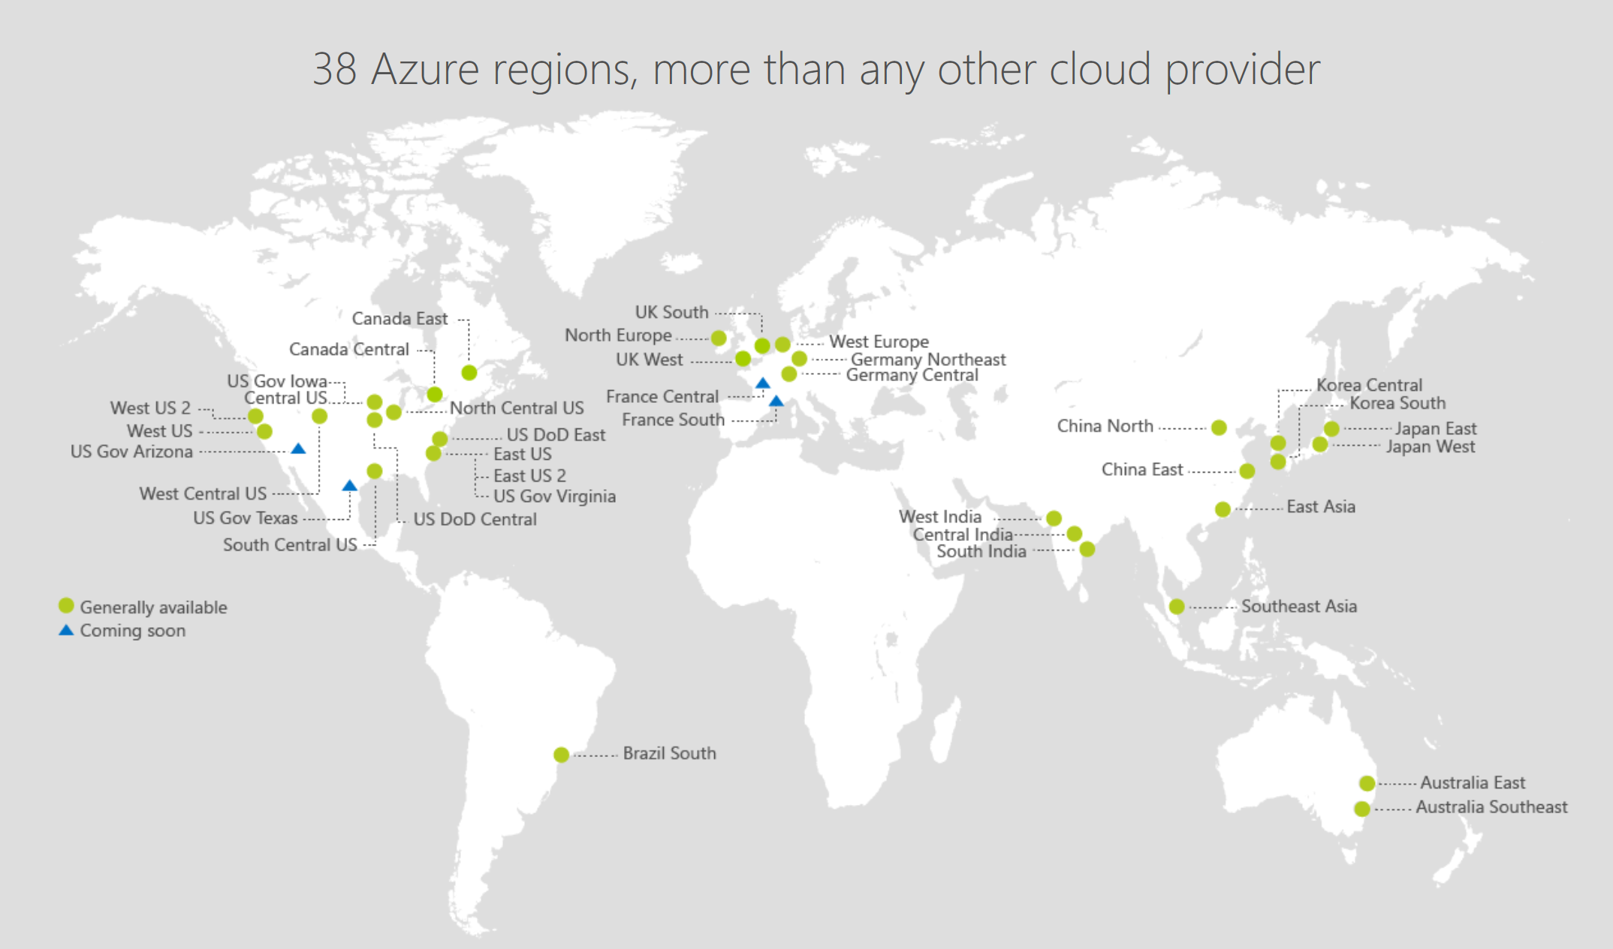
https://azure.microsoft.com/regions/
Notes:
http://azuredatacentermap.azurewebsites.net/

Slide 5
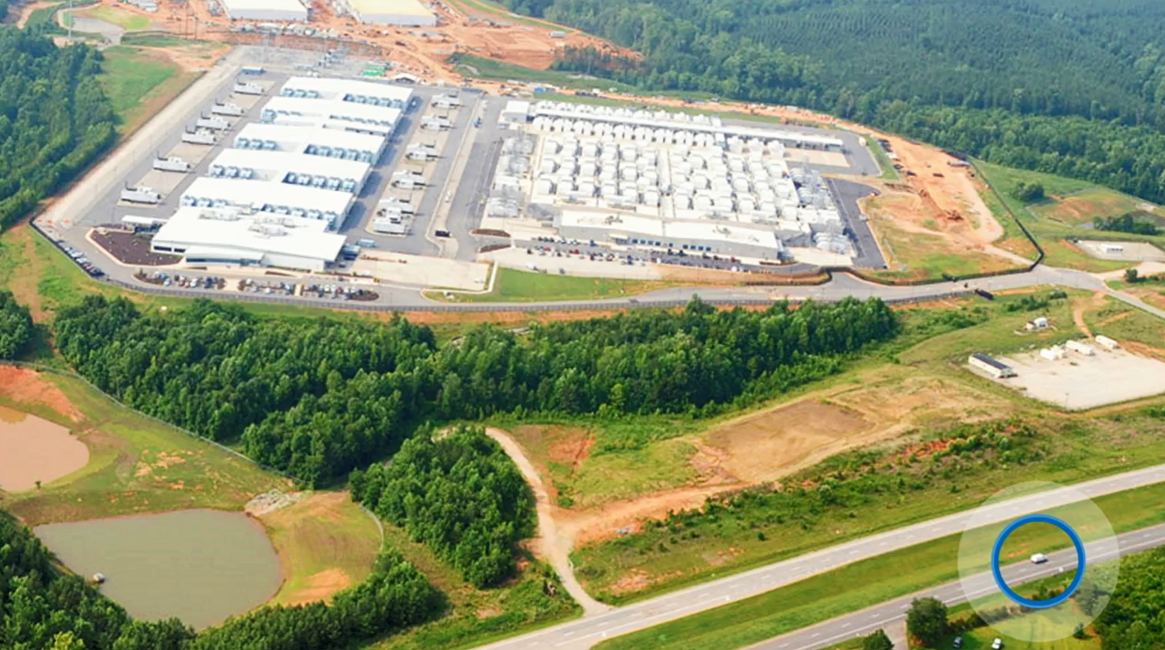

Slide 6

https://www.microsoft.com/en-gb/cloud-platform/global-datacenters
Notes:
https://www.microsoft.com/en-gb/cloud-platform/global-datacenters

Slide 7
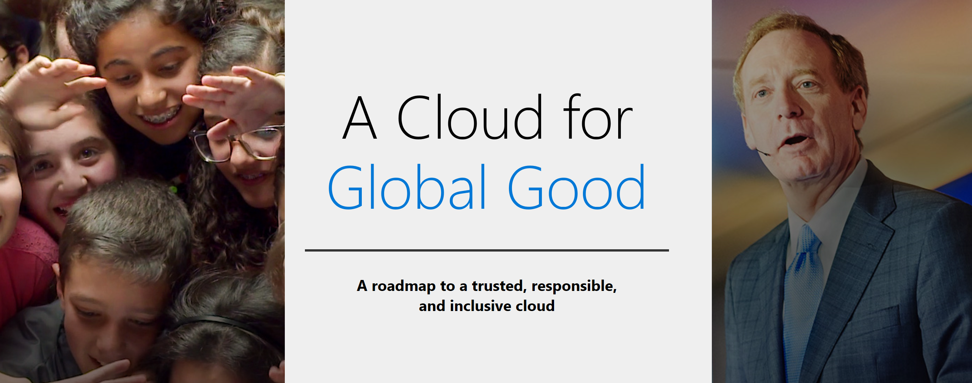
news.microsoft.com/CloudForGood

Slide 8
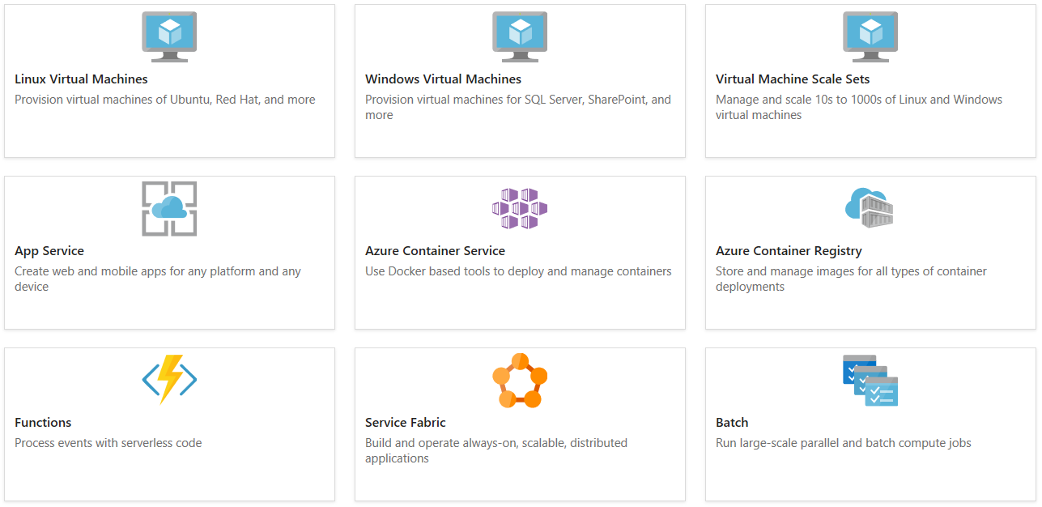
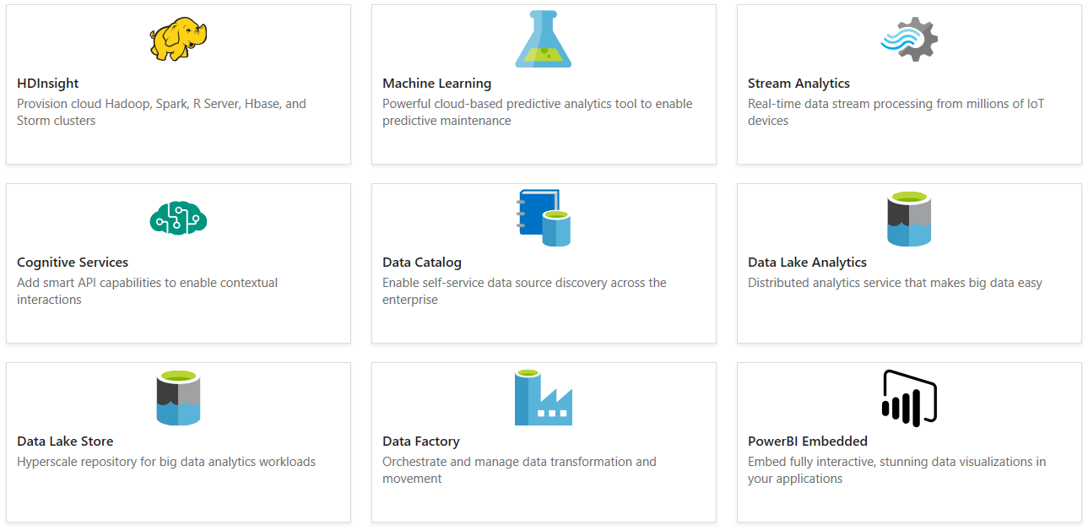
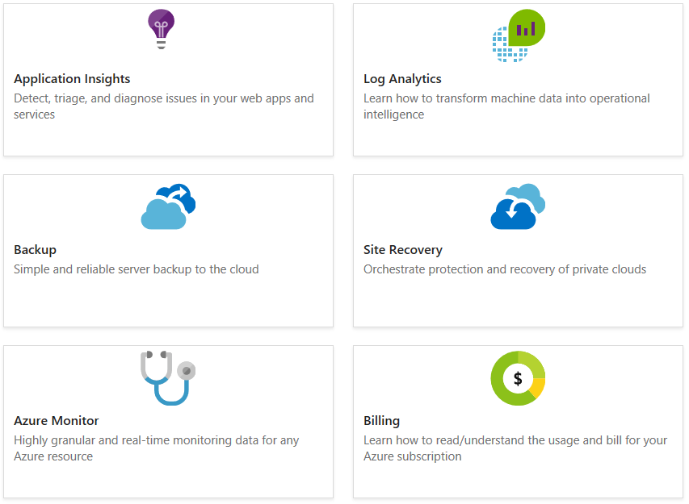
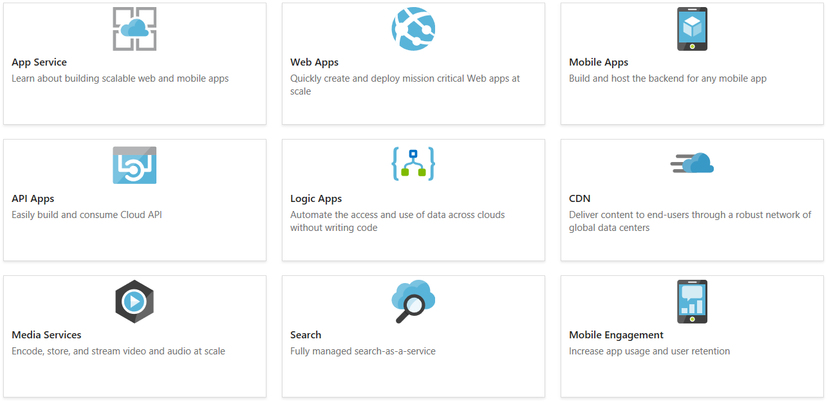
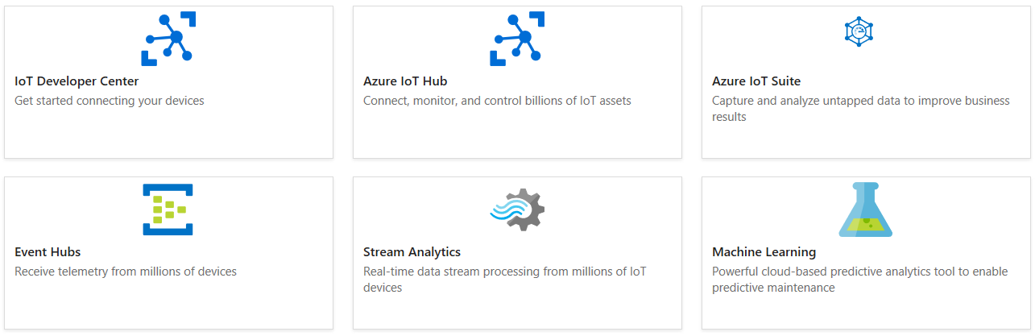
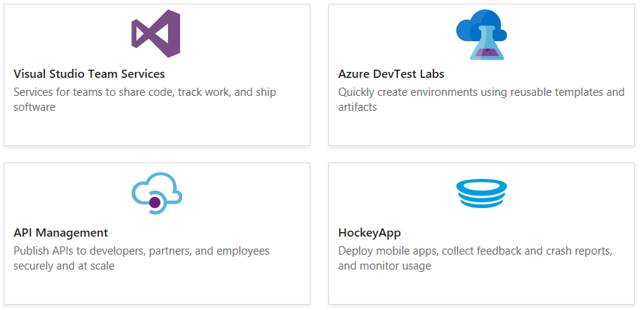
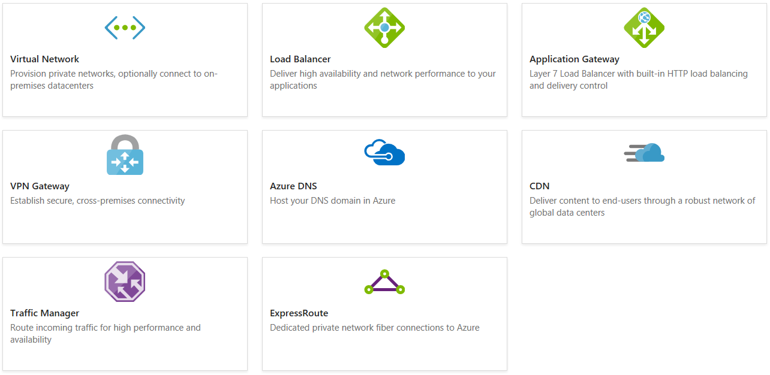
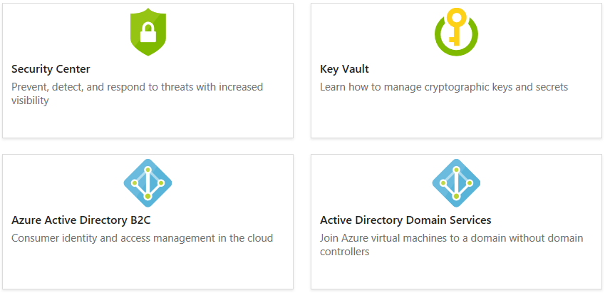
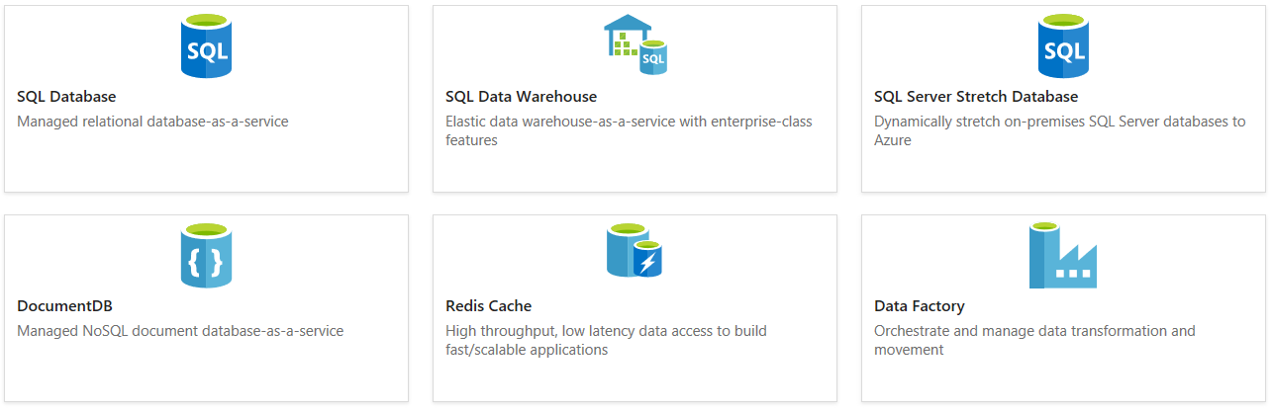
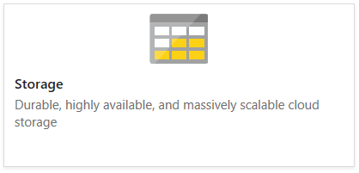
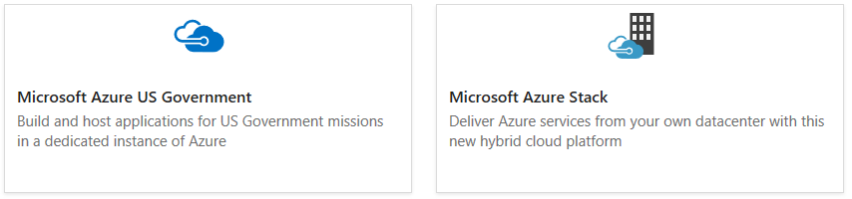
https://docs.microsoft.com/azure/

Slide 9
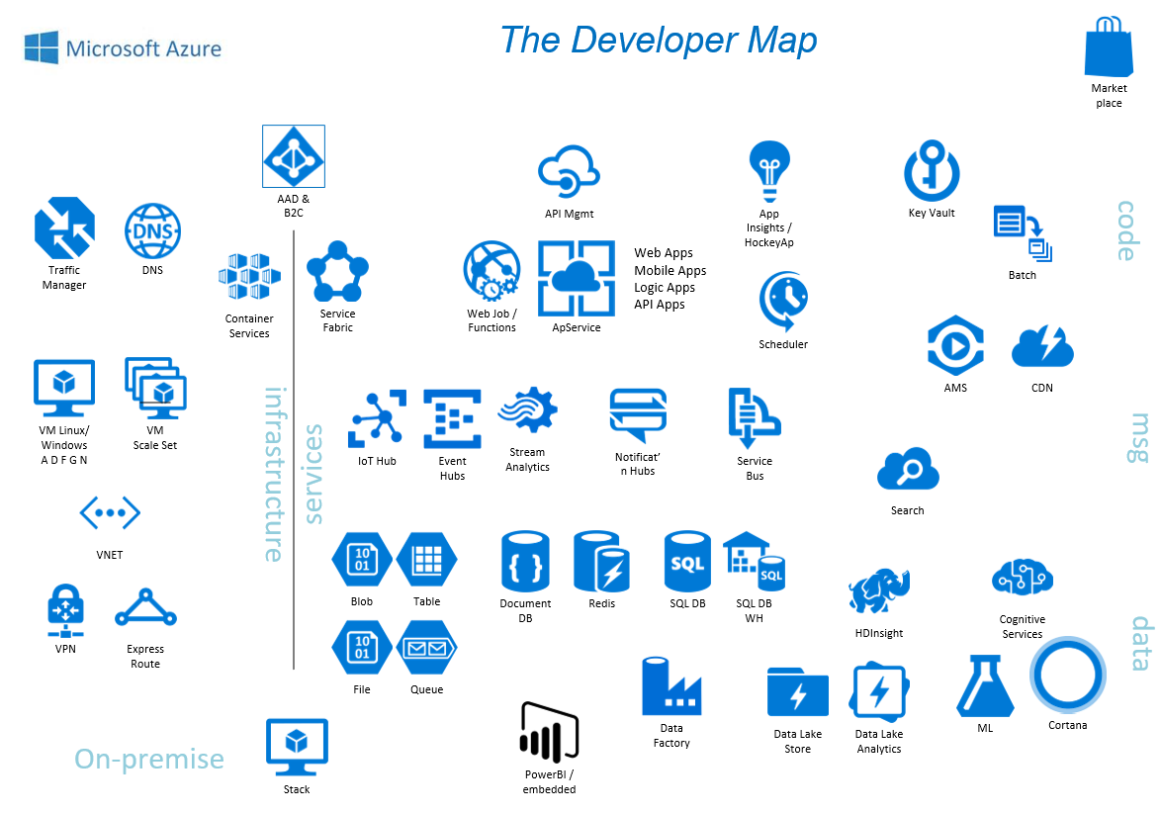

Slide 10

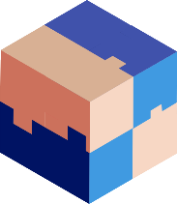




Evolution to Microservices
Monolith Client/Server 3-tier Microservices

Slide 11
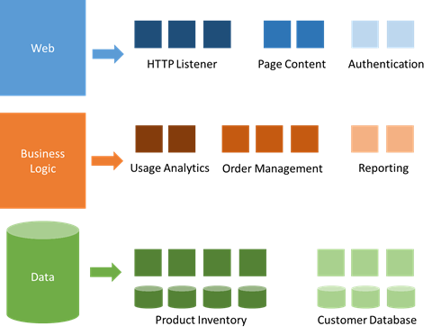
Anatomy of a Microservice architecture

Slide 12
Serverless Computing
Abstraction of the underlying system
Technical benefits
Deploy code that just runs, nothing to patch, manage or maintain
Simple, predictable testing, DevOps
Business benefits
Just pay for the resources consumed
No provisioning of budget, hardware, time

Slide 13
Functions
Agility
App Service
Service Fabric
Azure
Container Service
Virtual Machine Scale Sets
Virtual Machines
Control

